Slide 1
Mastering GIFs in PowerPoint
This is the original power point presentation that won me the “Best Talk” award at Australian Evolution Society 2022.
I have kept all the original slides, but on top of them I added comments to explain how the animations work.
The conference format tolerated quirky presentations, as long the science was still on point. GIFs and animations can certainly find their use in more formal talks.
By Ivan Vinogradov | cognivan.com

Slide 2
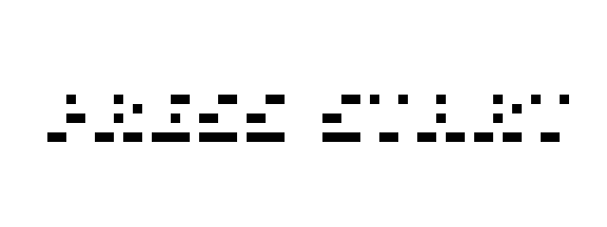


General Intelligence and its effect on paternity
This is a blinking “PRESS START” GIF. It sets the theme and keeps the slide alive while microphones are being set up and the audience gets in their sits.
NAME: IVAN VINOGRADOV
@IvanVin_

Slide 3
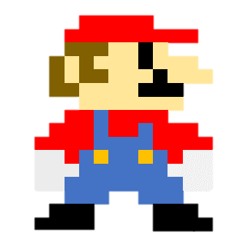
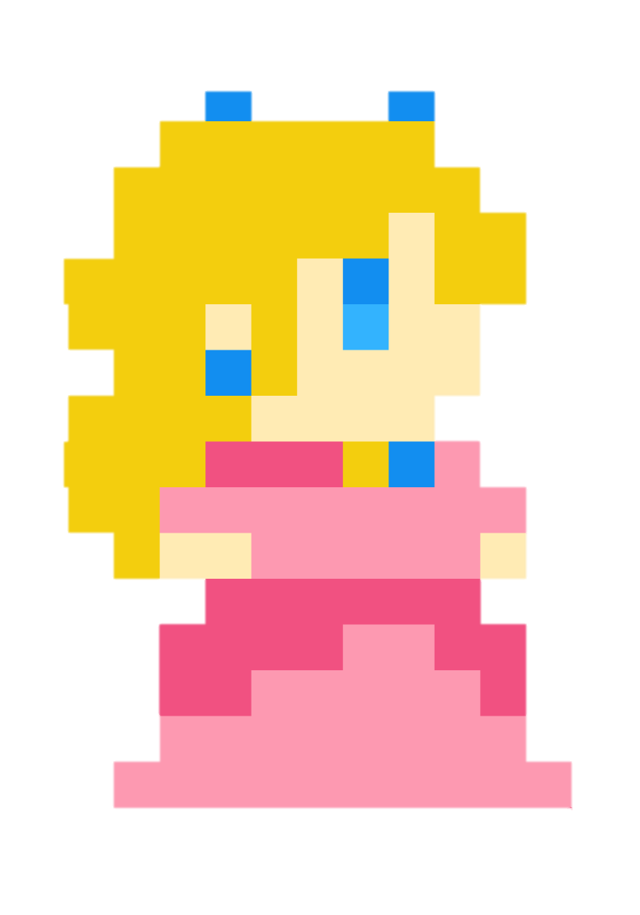
The princess simply moves in a straight line without animations. Since her legs are covered, we perceive this as walking.
Mario appears with a simple “Peek In” animation

Slide 4

Health
Strength
FITNESS
Immunity
Attractivness
Carefully drawn custom motion path
Each coin is a GIF with a transparent background. It keeps the slide alive and makes you believe you are watching a video game, not a PowerPoint.

Slide 5
Health
Strength
FITNESS
Immunity
Attractivness

Slide 6
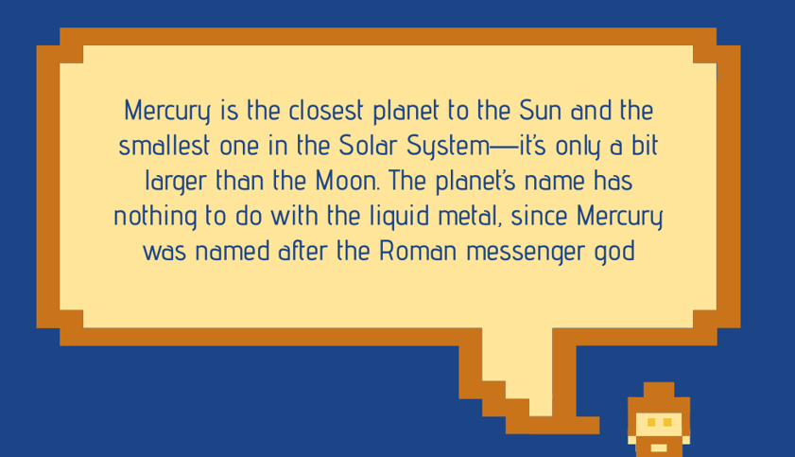
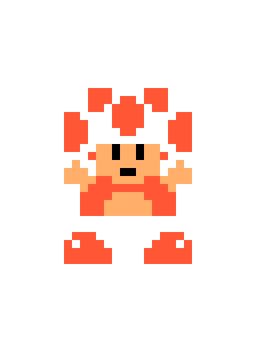
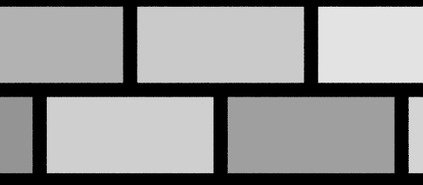
Cognition
“Push” slide transition make it seem like we are traveling underground.
OUR PRINCESS IS IN ANOTHER CASTLE… YOU DUMB-DUMB
Text appears “by letter” with a 0.1 second delay.

Slide 7
Cognition
FITNESS
Hard to quantify
Hard to measure in non-humans
Highly variable
Tricky to measure
Environment dependant

Slide 8

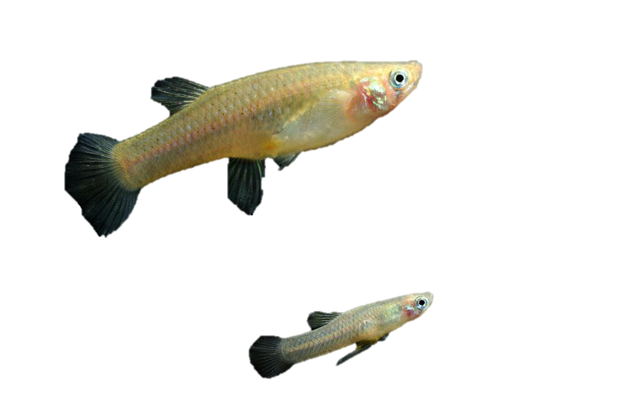
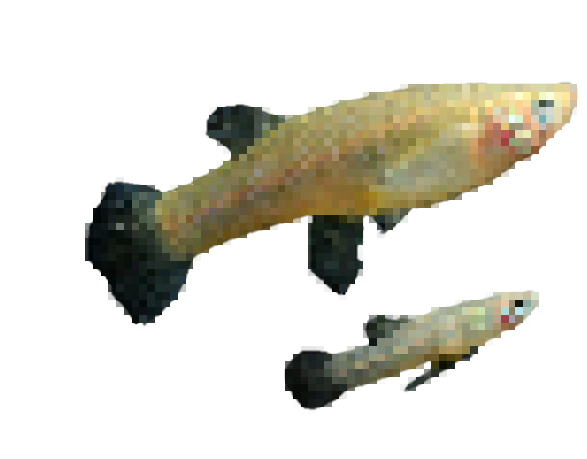
Self-control
Navigation
Learning
Re-learning
Bubbles are GIFs with transparent background.
Cognition
Mosquitofish (Gambusia holbrohii )
Pixelated objects can be easily made from images using online tools.
♂
n = 140 fish

Slide 9
Animation like this can be easily made with a smart “Morph” transition. I did not know this at the time.
I moved each heading in a straight line to the bottom position. Then I duplicated the slide, so that the headings are already aligned at the bottom of the next slide.
Self-control
Navigation
Learning
Re-learning

Slide 10
General Intelligence
Score
Self-control
Navigation
Learning
Re-learning

Slide 11
General Intelligence
~ OR ~

Slide 12
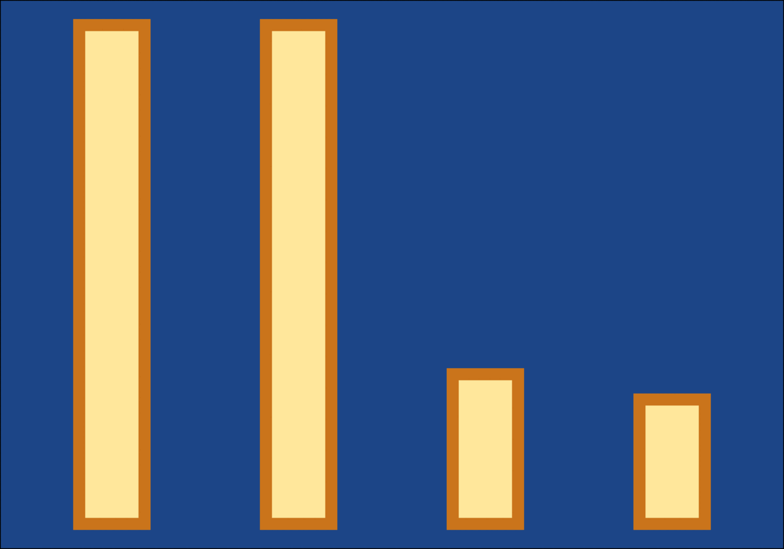
This is a custom GIF I made from scratch. I used R and ggplot2 to make plots of my data, matching the color of bars and background to my presentation.
I imported ~100 bar plots and merged images into a GIF using online tools. Lastly, I simply copy-pasted the GIF into this slide.
It took a bit of work…
Smart
Not smart
Learning
Re-learning
Navigation
Self-control
♂

Slide 13
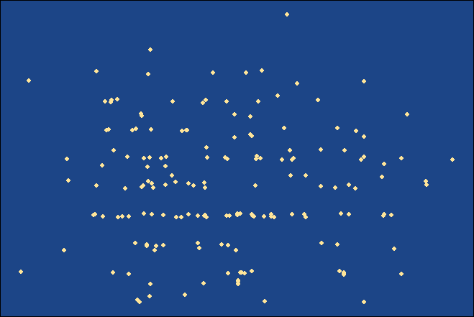
Correlation 1:
Navigation
Nothing special here…
Self-control

Slide 14
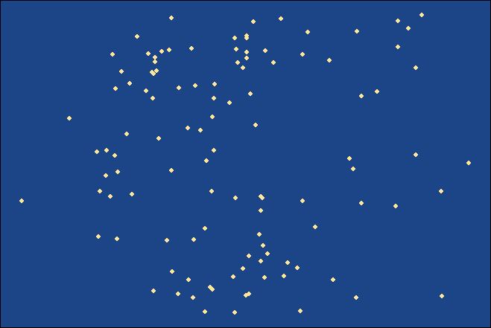
Correlation 2:
Learning
Nothing special here…
Self-control

Slide 15
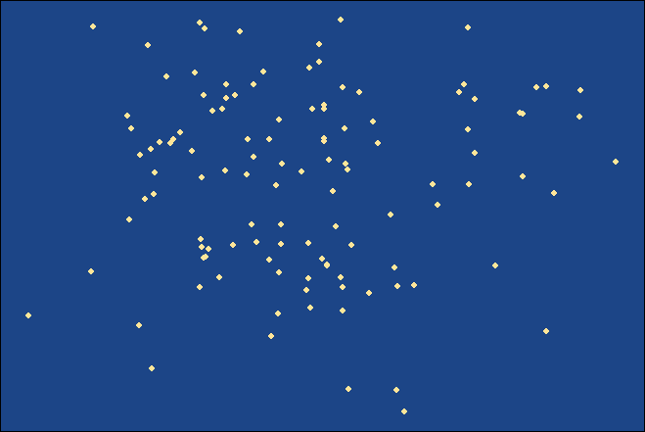
Correlation 3:
Re-learning
Nothing special here…
Self-control

Slide 16
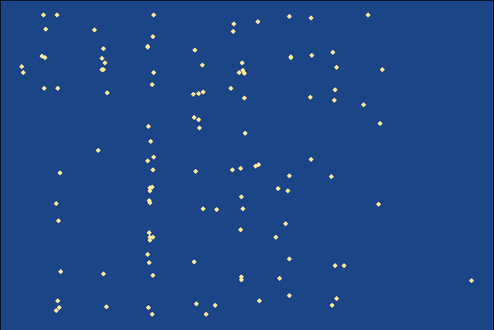
Correlation 4:
Learning
Nothing special here…
Navigation

Slide 17
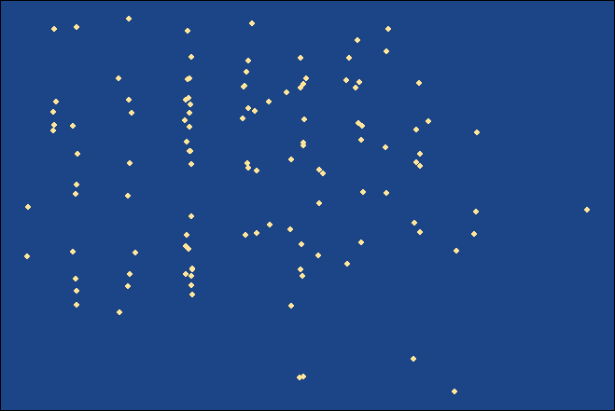
Correlation 5:
Re-learning
Nothing special here…
Navigation

Slide 18
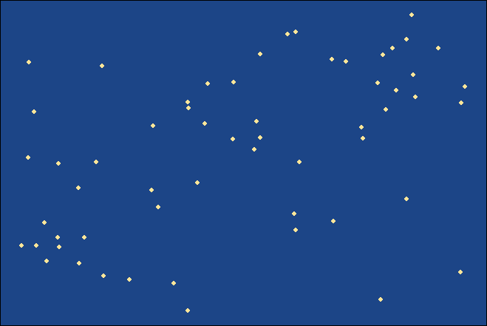
Correlation 6:
Re-learning
Nothing special here…
Learning

Slide 19
General Intelligence
~ OR ~
Overall weak evidence for general intelligence

Slide 20
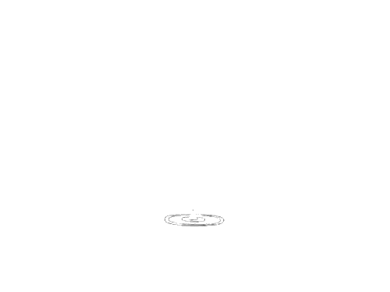
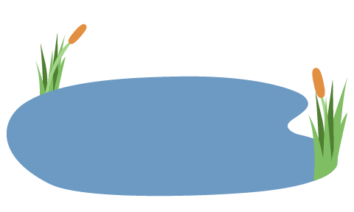
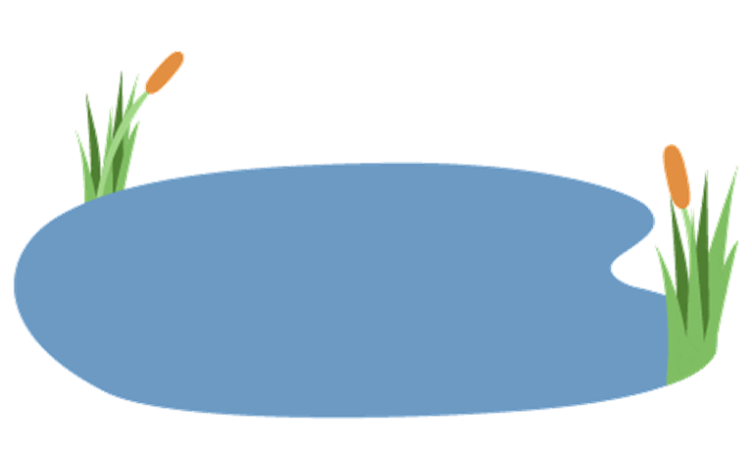
Paternity
focal males
♂
♀
♂
♀
♂
♀
This is a GIF of a pond and another one of rain drops on top. Again, this simply keeps the slide alive.
Total 11 mating ponds
♂
♀

Slide 21
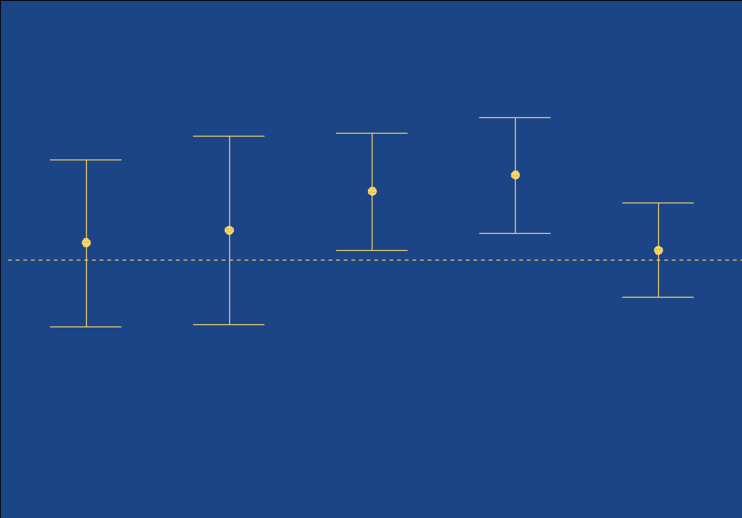
Error bars = 95% CI
0.5
**
**
Correlation with paternity
0
I always reveal information on busy slides one step at a time.
Here, its done by “fading” blue rectangles that match the color of the background.
-0.5
Learning
Navigation
Re-learning
Self-control

Slide 22

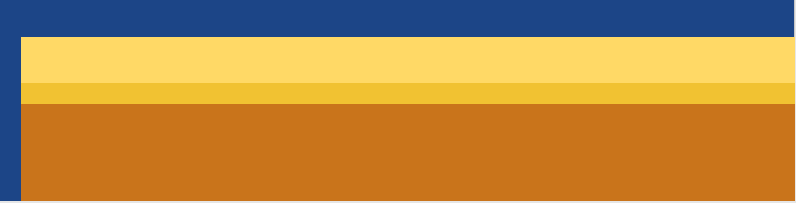
Takeaways
I had some many people approach me and ask how this animation was made.
This is a GIF I found of a turtle spinning in place.
By giving it a realistic path of motion with bouncing, it turns into a proper video game unit.
This gives our audience one extra ‘WOW’ moment right at the end.
Learning and un-learning are correlated
Weak evidence for general intelligence
Cognition can be correlated with paternity

Slide 23
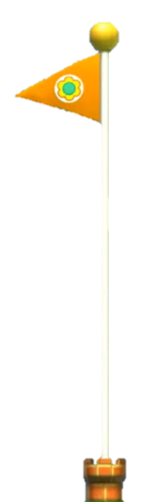

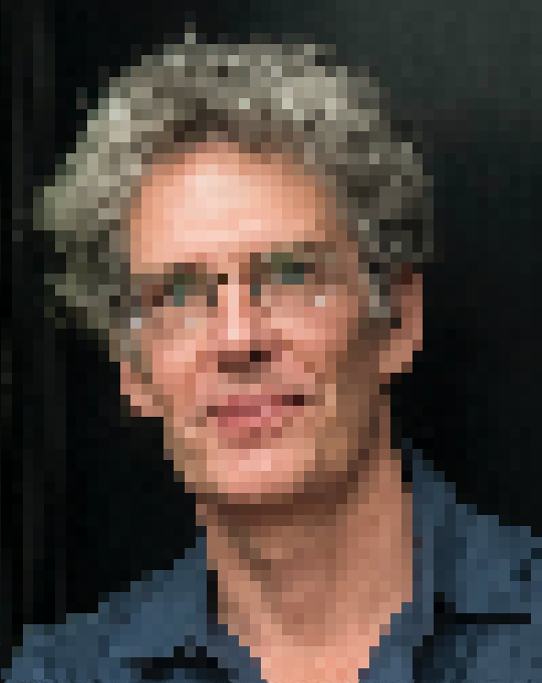

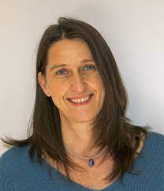
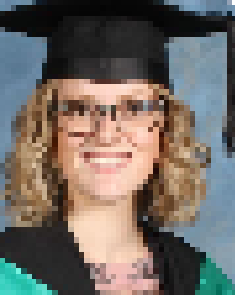

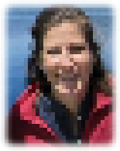

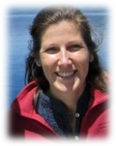
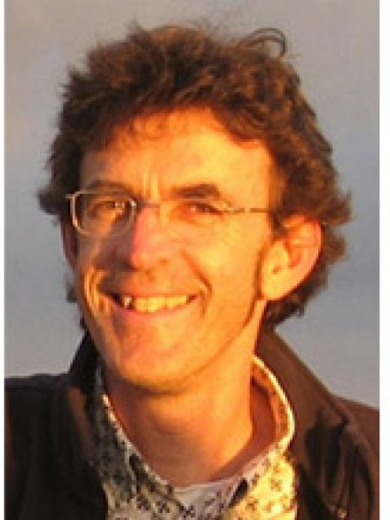

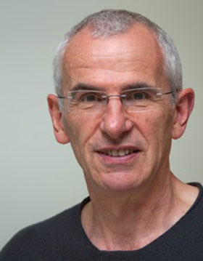
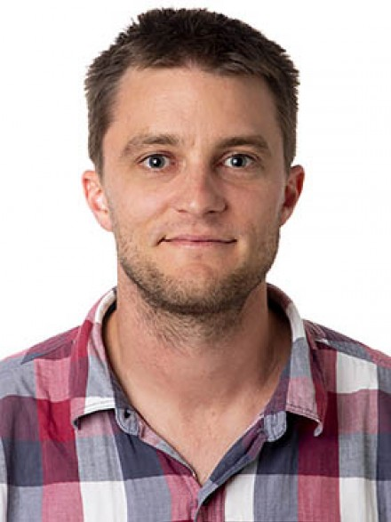
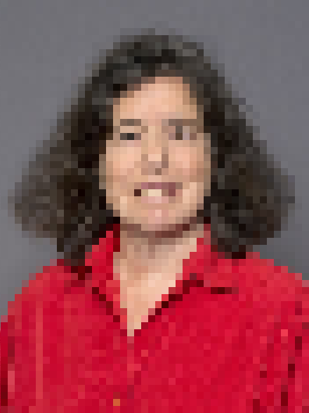

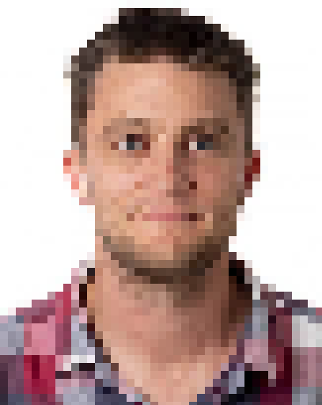

Thank you
Michael Jennions
Rebecca Fox
Eleanor van Veen
Claudia Fitchel
I cut out the flag portion of the image and turned it into a separate object. This way, I could move it independently from the pole.
Rob Magrath
Peter Kappeler
Dan Noble
Teresa Neeman
Pixelated images “fade” away, revealing actual portraits.
+ the Jennions Lab team !

Slide 24

Takeaways
Learning and un-learning are correlated
Weak evidence for general intelligence
Cognition can be correlated with paternity
@IvanVin_
The last slide stays alive thanks to these moving coins.

Slide 25
THANKS!
I use a free slide template. I mostly used its background and color palette, while all the objects and GIFs were found elsewhere.
Please keep this slide for attribution.

